Slide 1



DermAI Diagnostics Skin Cancer Analysis

Slide 2

PROBLEM STATEMENT
Skin cancer is one of the most common and life-threatening diseases, yet early detection can significantly improve survival rates. Our business, DermAI Diagnostics, leverages machine learning and clinical dermatology research to enhance early diagnosis and treatment. By analyzing patient demographics, environmental factors, and lesion characteristics, we create data-driven insights to assist dermatologists in early-stage detection and decision-making.
Through a combination of AI-powered diagnostic tools, real-world clinical data, and SQL-based research, our company aims to bridge the gap between medical practitioners and machine learning-based skin lesion classification. By providing a structured dataset and digital tools, we support medical research, epidemiological studies, and AI-driven skin cancer detection, ultimately improving public health outcomes.

Slide 3
PROBLEM STATEMENT
Skin cancer detection is often delayed due to misdiagnosis, lack of access to dermatologists, and limited understanding of environmental risk factors. with 1,089 instances of skin lesions in our dataset, we aim to uncover key patterns that link demographics, environmental exposure, and lesion characteristics to different types of skin cancer. this project seeks to enhance early-stage diagnosis and machine learning-based decision support by structuring the data for SQL queries, analysis, and model training.

Slide 4
RATIONALE FOR THE PROJECT
Bridging Data And Medicine
Early Detection & Prevention
Ai-driven Medical Research
Real-world Application
SQL Learning Opportunity

Slide 5
AIM OF THE PROJECT
Develop a SQL database for students to practice joining clinical and lesion data for effective skin cancer analysis.
Identify environmental and demographic risk factors that correlate with specific skin lesions.
Analyse lesion characteristics to find patterns that indicate cancerous vs. Benign lesions.
Create a machine learning-ready dataset that supports ai-based early detection of skin cancer using structured metadata.
Enhance dermatological research by providing a well-organized dataset for epidemiological studies and ai model training.

Slide 6

PROJECT WORKFLOW
Import The Dataset
Join Tables
Write Queries
Recommendation

Slide 7
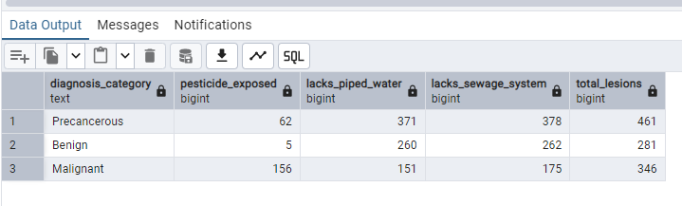
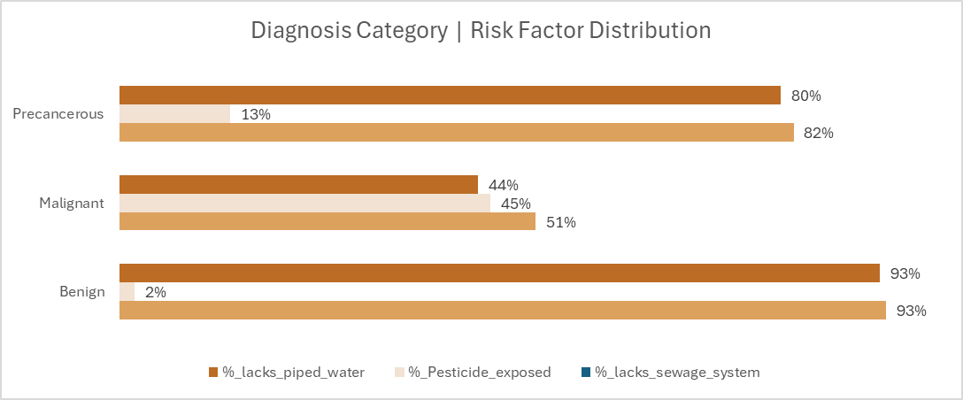
Environmental Risk Factors
Findings:
Precancerous Lesions
With 461 total cases, 13.45% of cases were exposed to pesticides, 80.48% lacked piped water while 82% lacked a sewage system.
Benign Lesions
With 281 total cases, Only 1.78% were exposed to pesticides, 92.53% lacked piped water while 93.24% lacked a sewage system.
Malignant Lesions
With 346 total cases, 45.09% were exposed to pesticides (highest among categories), 43.64% lacked piped water while 50.58% lacked a sewage system.

Slide 8
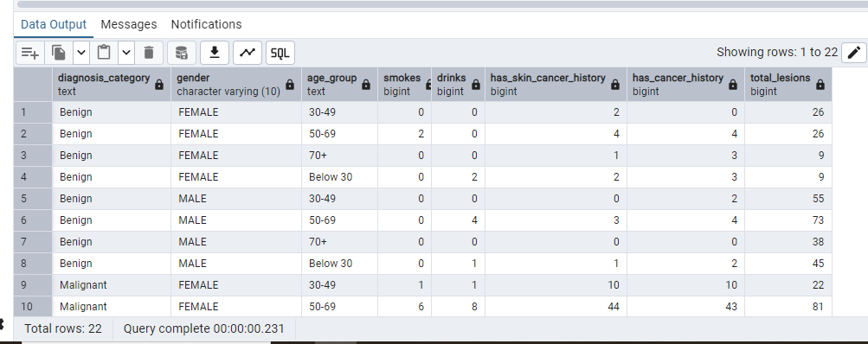
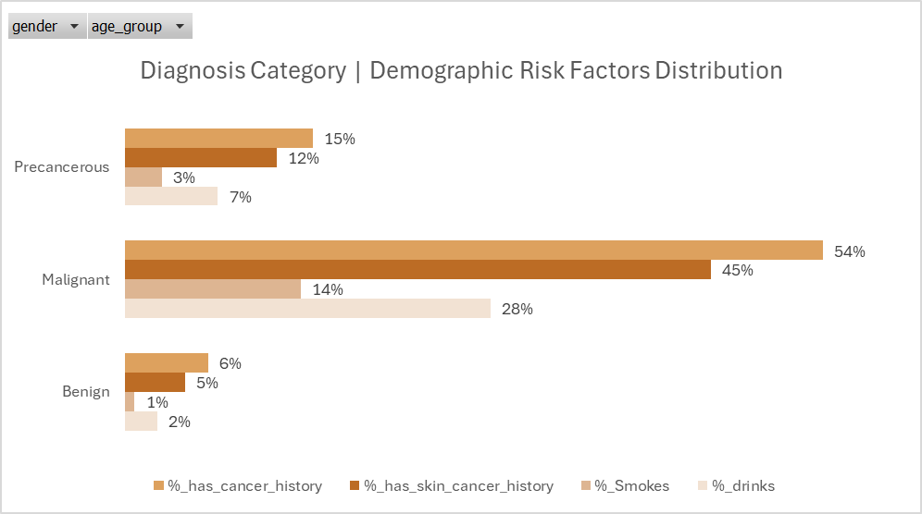
DEMOGRAPHIC Risk Factors

Slide 9
DEMOGRAPGHIC Risk Factors FINDINGS
Benign lesions:
Most cases are in older age groups (50–69, 70+).
Very low rates of smoking and drinking.
Cancer history is present in a small percentage (up to 5.48%).
Skin cancer history is rare.
Malignant lesions:
Highest rates of smoking and drinking, especially in age groups 50–69 and 70+ (smokes_pct up to 23.66%, drinks_pct up to 59.26%).
Significant proportion have a history of skin cancer (up to 51.85%) and general cancer history (up to 57.97%).
Malignant cases are more common in older males.
Precancerous lesions:
Moderate rates of smoking and drinking, increasing with age.
Cancer history and skin cancer history are present but less than in malignant cases.

Slide 10
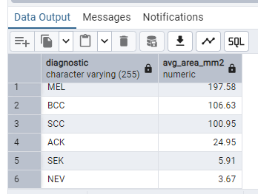
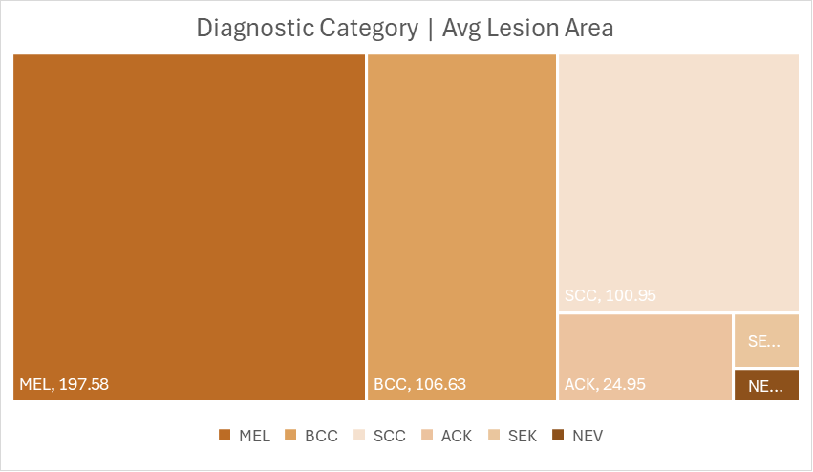
DIAGNOSIS VS AVG LESION SIZE
MEL (Melanoma): Largest average lesion area (197.58 mm²).
BCC (Basal Cell Carcinoma): Large average lesion area (106.63 mm²).
SCC (Squamous Cell Carcinoma): Large average lesion area (100.95 mm²).
ACK (Actinic Keratosis): Moderate average lesion area (24.95 mm²).
SEK (Seborrheic Keratosis): Small average lesion area (5.91 mm²).
NEV (Nevus): Smallest average lesion area (3.67 mm²).

Slide 11
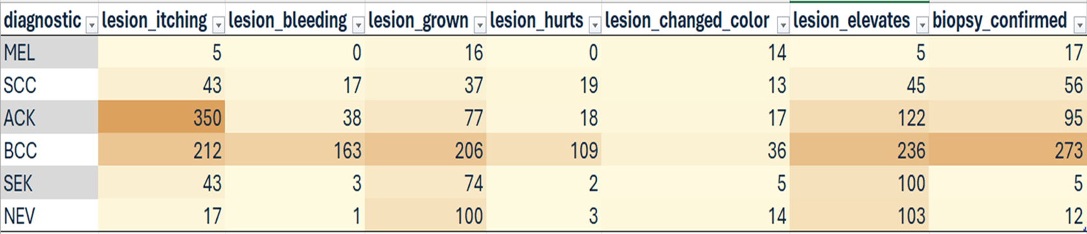
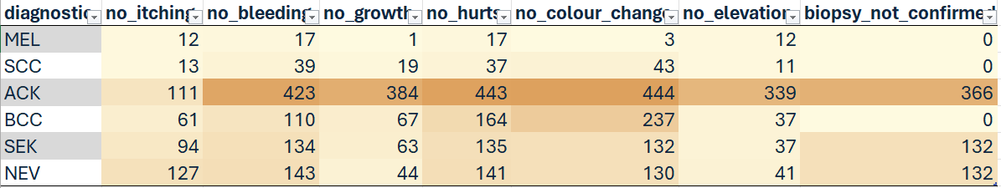
CANCER SYPMTOMS INDICATOR
SUMMARY:
Malignant lesions (MEL, SCC, BCC) show strong biopsy confirmation rates even when symptoms are few. In contrast, benign and precancerous lesions, particularly ACK, often remain unbiopsied despite high symptom counts, this may carry hidden risk and suggest potential gaps in diagnostic follow-up.

Slide 12
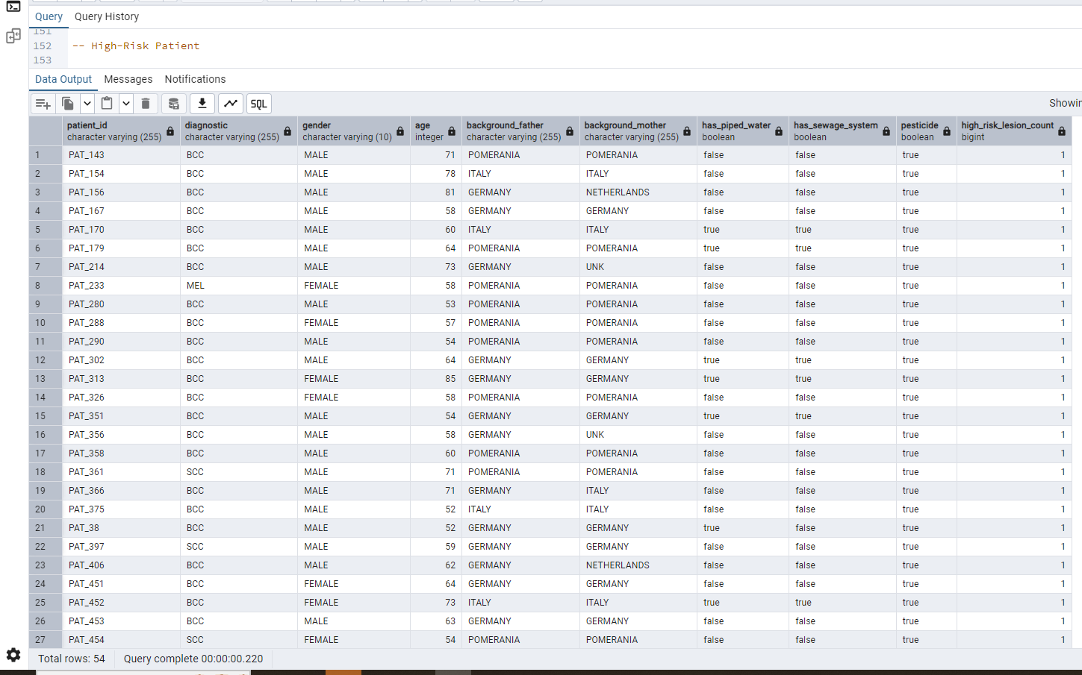
High Risk Patient

Slide 13
HIGH RISK PATIENT SUMMARY
54 high-risk patients were identified, most of whom are older adults (age > 50) with a personal history of skin cancer and environmental risk factors(mostly pesticide exposure and, in many cases, lack of piped water and sewage systems).
Most of the high-risk lesions are BCC, with a few MEL(Melanoma) and SCC cases. Most patients are from Germany, Pomerania, or Italy, and both males and females are represented.

Slide 14
GENERAL SUMMARY
Environmental risks like pesticide exposure are higher among malignant lesions.
Demographic patterns show older patients and males are more prone to malignant lesions.
Lesion size is generally larger in malignant diagnostic category.
Many benign lesions show no symptoms and remain unbiopsied, which may risk missing early transformations.
The high-risk patients table combines multiple risk factors which can be further analyzed.

Slide 15
RECOMMENDATIONS
Prioritize high-risk patients:
Screening and follow-up on older patients with prior skin cancer history and environmental exposures.
Monitor asymptomatic lesions:
Periodic evaluation of benign lesions, especially in high-risk patients, even if asymptomatic.
Integrate findings for further analysis:
Utilize the output of this analysis for further machine learning to build models for predicting skin cancer risk.
Public health enhancement:
Awareness on environmental risks, emphasizing pesticide exposure’s potential links to malignancy.

Slide 16
THANKS FOR LISTENING

